Slide 2
Risk management

Slide 3

The company killed by the code (According to uncle bob)
C Debugger
1988 Sword Inc.
Commercially successful C-debugger.
Many companies moved to C++
Sward Inc. Promised C++ debuger

Slide 4
The company killed by the code (According to uncle bob)
1990 Sword Inc delivered a C++ debugger
Loading time: 45 Min, debugger crashed
Release 2: six months later
Still with the same bug
C++ Debugger

Slide 5

The company killed by the code (According to uncle bob)
Most customers cancelled their contracts
Some even sued Sword Inc.
Sword Inc. went bankrupt

Slide 6


Interview with a Former Sword Inc. Employee
We rushed…
… and made a huge mess in the code

Slide 7

What Happened?
Marketing: We need to be the first!
Continuous bug fixing, high-priority features
No time for refactoring, clean up
Lots of work with little to show for it
Code that can‘t even parse C++ with no way to fix it

Slide 8
The Productivity Trap
Scary Gap!
Productivity
Time

Slide 9
The Productivity Trap
Developers
Can initially make fast progress
Get slower over time
Manager
Plan with initial velocity
Promise unrealistic results and completion times

Slide 10

The Productivity Trap
Developers
Need to work faster and faster, and longer and longer hours
Have no time for refactoring
Code base
Becomes rigid, fragile, inseparable, opaque
Everybody
Is unhappy

Slide 11

What can Management Do?
Initial Problem:
Developers became slower and slower without any apparent reason.
What to do?

Slide 12
What can Management Do?
Remind developers about their responsibilities?
Introduce better working model?
Talk to developers to motivate them?
Shorten deadlines and order overtime?
Threaten to fire developers?
None of these solutions will solve the problem!

Slide 13
Strategies to Resolve this Crisis
Add more people
Brook’s law: Adding people to a late software project makes it later

Slide 14
More People: Theory
Scary Gap!
Productivity
More People
Time

Slide 15
More People: Reality
Productivity
Scary Gap!
More People
Time

Slide 16
Strategies to Resolve this Crisis
Add more people
Brook’s law: Adding people to a late software project makes it later
Big redesign
Stop development and spend some months/years cleaning up?
How do we know that this doesn’t break the code?

Slide 17
Strategies to Resolve this Crisis
Restart from scratch
Tiger team with the best developers
Now we have two competing teams and software versions
Small, incremental redesign
Boy scout rule: slowly improve the code
Write new code using agile practices (e.g., TDD, clean code)

Slide 18

The boy scout rule
Robert B. Powell (inspirational figure for the scouting movement)
Leave the world better than you found it!

Slide 19
The boy scout rule
Robert C. Martin (author of Clean Code)
Leave your code better than you found it!

Slide 20
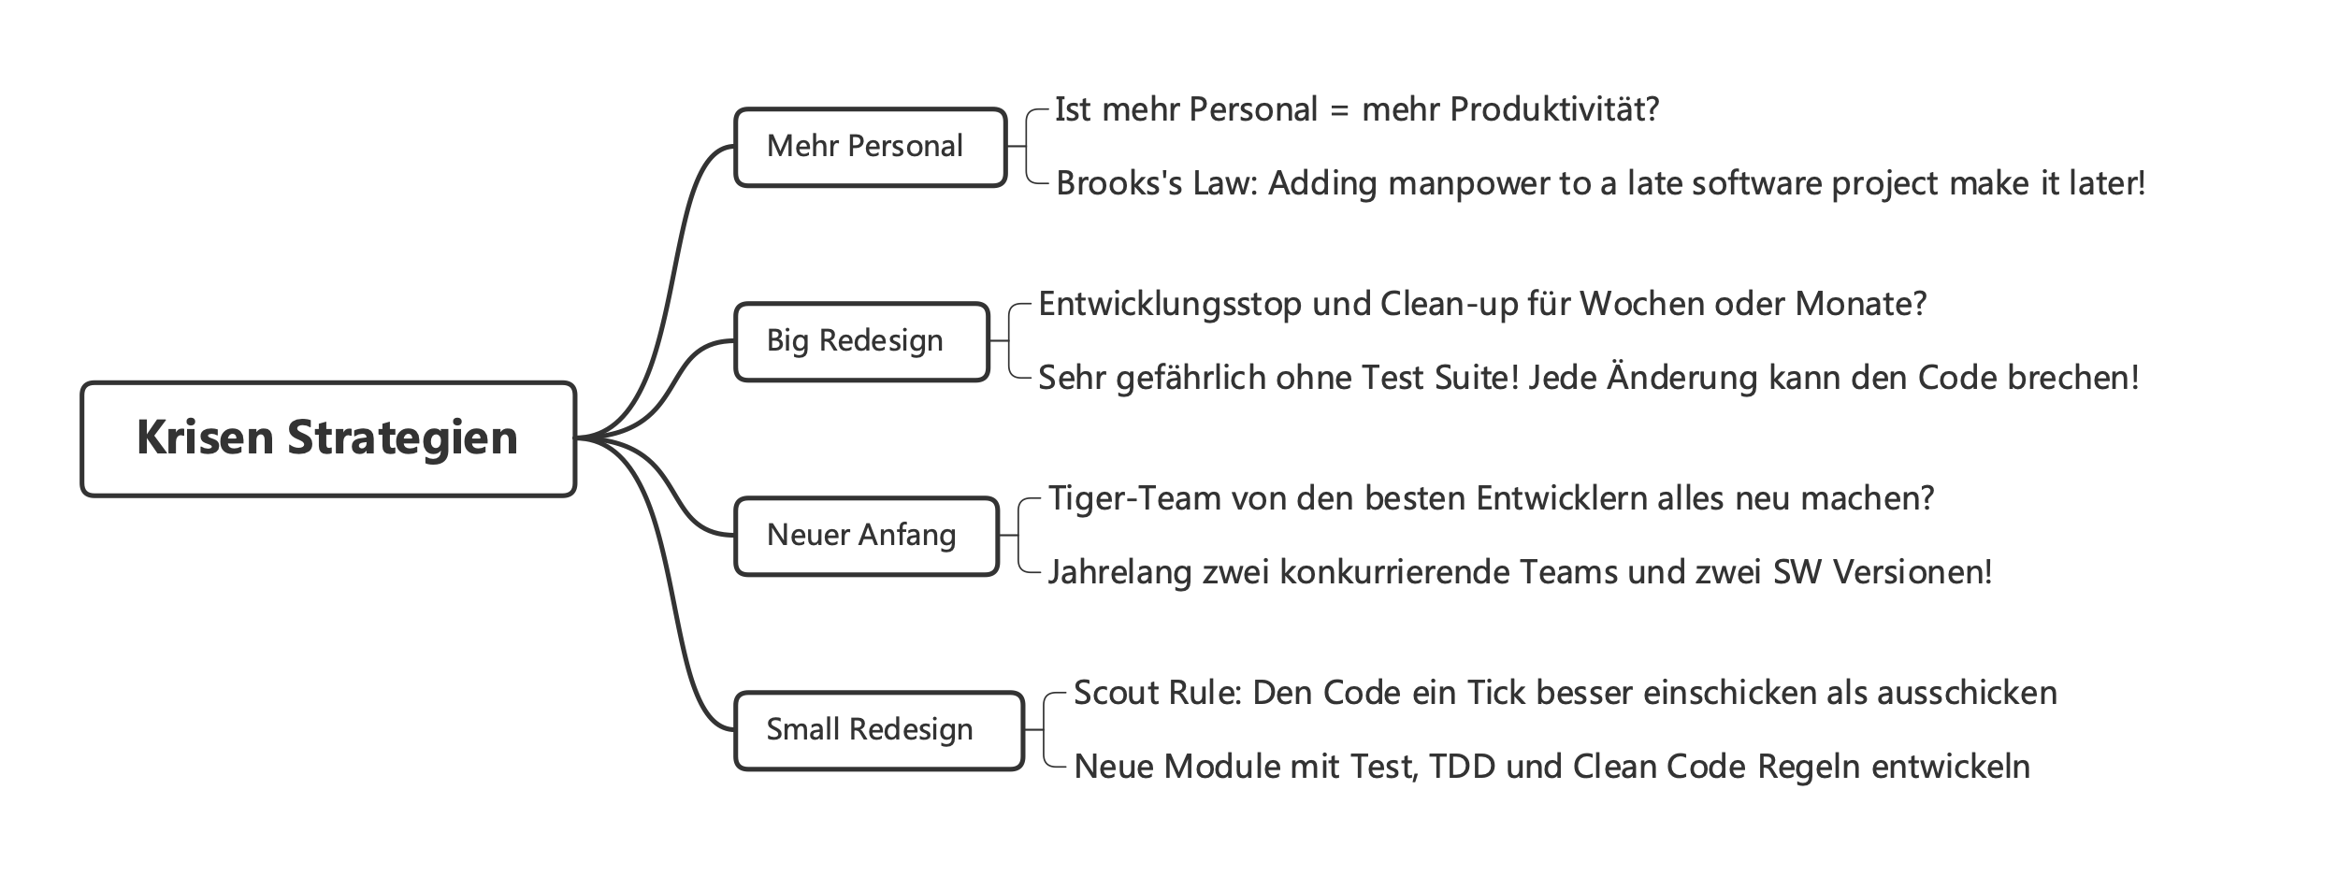

Slide 21

Why do we write bad code?
Stupid managers
Impatient customers?
Impossible timeframes?
These are (according to Uncle Bob) only pretexts.

Slide 22

Why do we write bad code?
Our hands are on the keyboard
We are responsible for code rot
Nobody else!
Whenever you rush, you make a mess!

Slide 23
Agile(?) Practices + Clean Code (Ideally)
3 months
Productivity
6 months
Time

Slide 24
How to deal with bad code
Don’t throw it away, improve it step-by-step
As soon as you see bad code, clean it!
Later = never.
Leave the campground cleaner then you found it!
Leave the world better than you found it!

Slide 25
If everybody improves the code a little bit...
(Often) No need for a big redesign! Steps that are doable.
Introduce a better variable name
Split a big function into smaller ones
Remove duplicate code
Remove some conditional statements
If everybody leaves the code a little cleaner than they found it, it does not rot!

Slide 26
How do we get clean code?

